Slide 1
CHAMBRELAN
WWW.CHAMBRELAN.COM
Markets & Examples of application
Transportation | Machines | Electronic | Military | Specials
Aircrafts
Production lines
19’’ racks
Stretcher drawers
Observatory
Ships
Clean rooms
UPS racks
Compressors
Fire places
Trains
Compressors
Electronic racks
Displays
Cooker hoods
SUVs
Food Industry
Drawers
Coaches & busses
Containers
Seats
Extensions
Guards & hoods
Simulators
Special vans
Furnaces
Ambulances
Transfer drawer
Emergency vehicles
Sorting machines
Special vehicles
For internal training purpose only; do not disclose ! All given information are given for your guidance and are subject to change without notice.

Slide 2
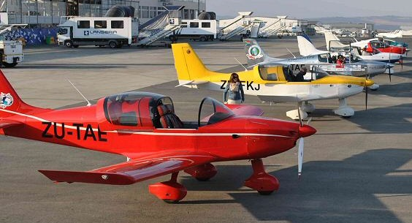
Aerospace
Markets & Examples
CHAMBRELAN
WWW.CHAMBRELAN.COM
Transportation | Plants & Machines | Electric & Electronic | Military | Specials

Slide 3
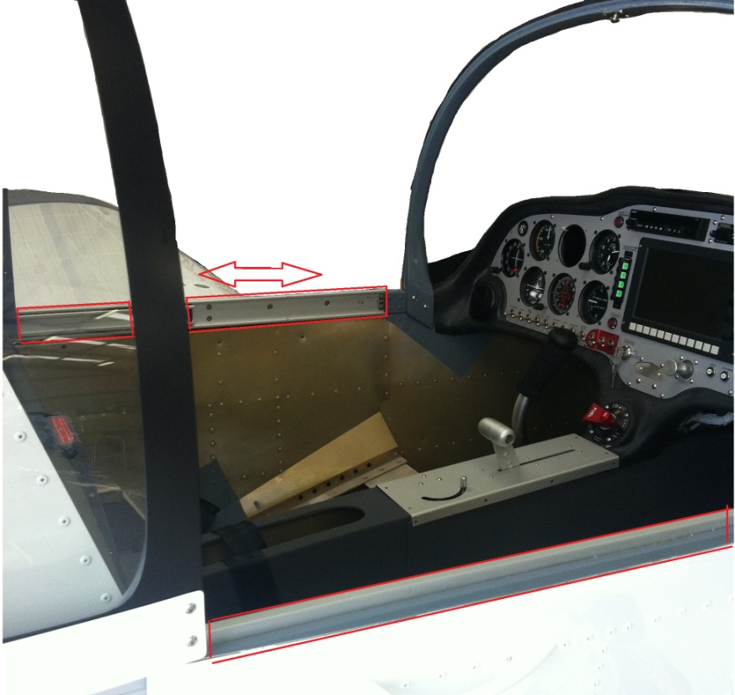
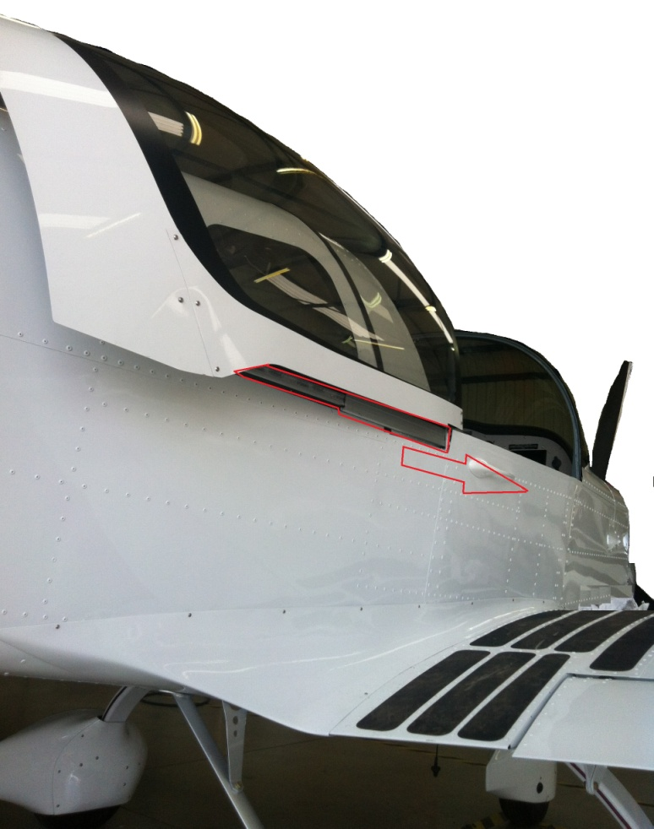
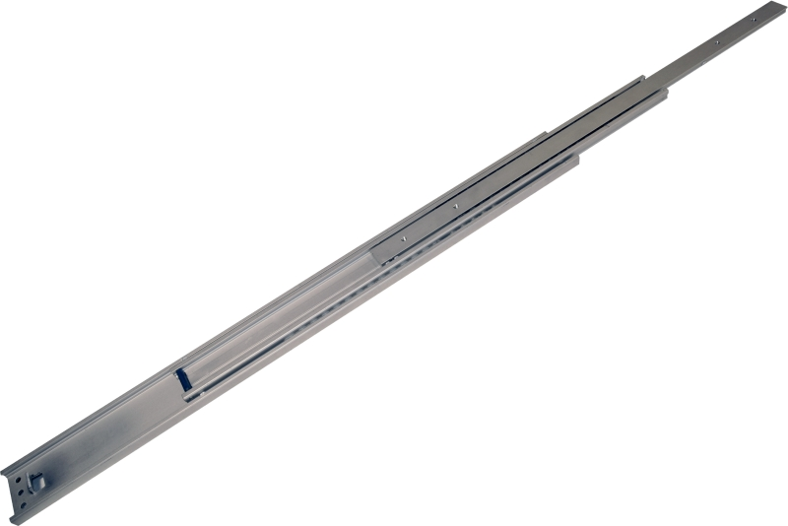
Aerospace : Cockpit sliding with D444
Markets & Examples
CHAMBRELAN
WWW.CHAMBRELAN.COM
Transportation | Plants & Machines | Electric & Electronic | Military | Specials

Slide 4
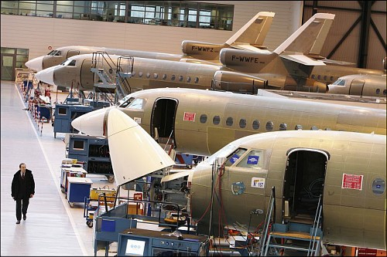
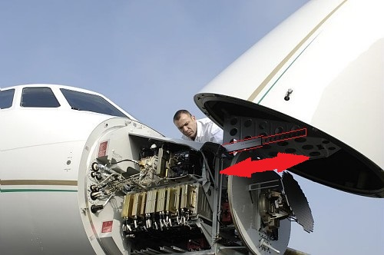
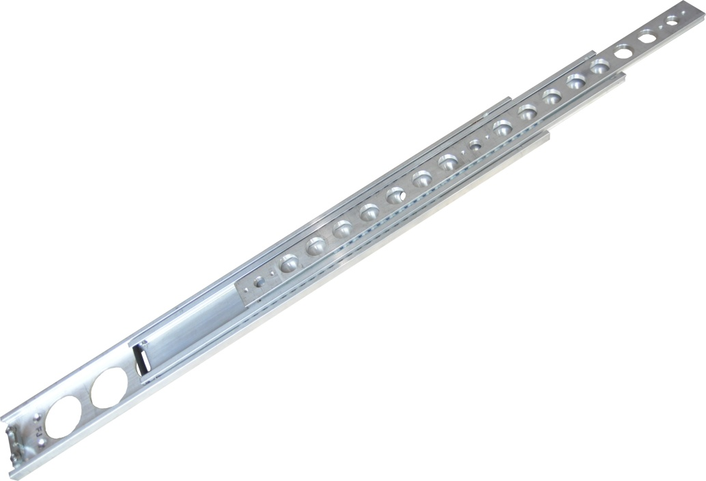
Aerospace : Flight radome
Markets & Examples
CHAMBRELAN
WWW.CHAMBRELAN.COM
Transportation | Plants & Machines | Electric & Electronic | Military | Specials

Slide 5
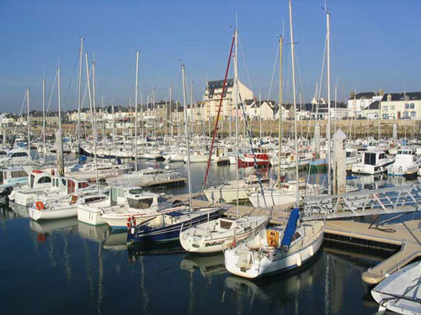
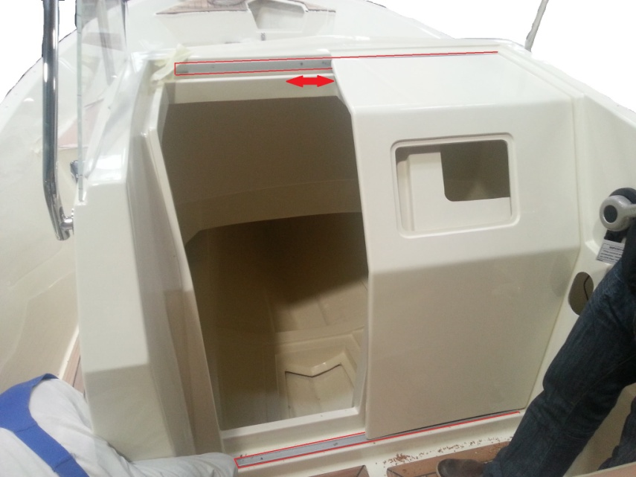
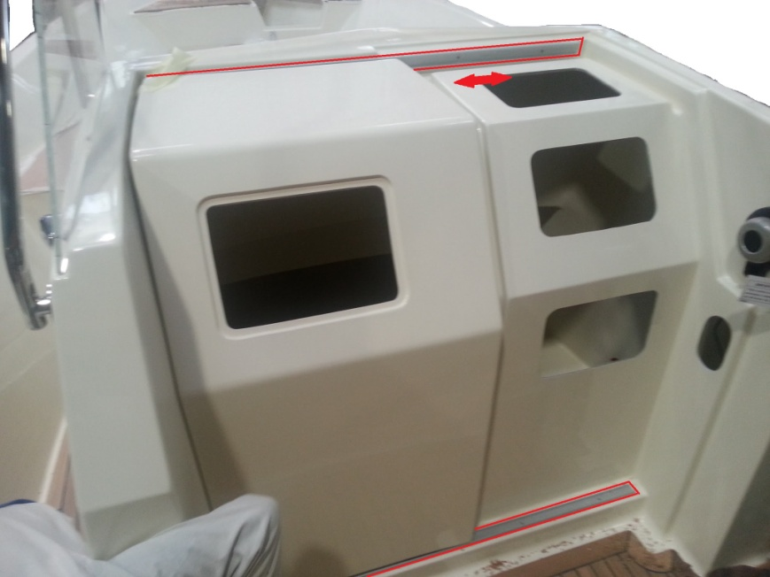
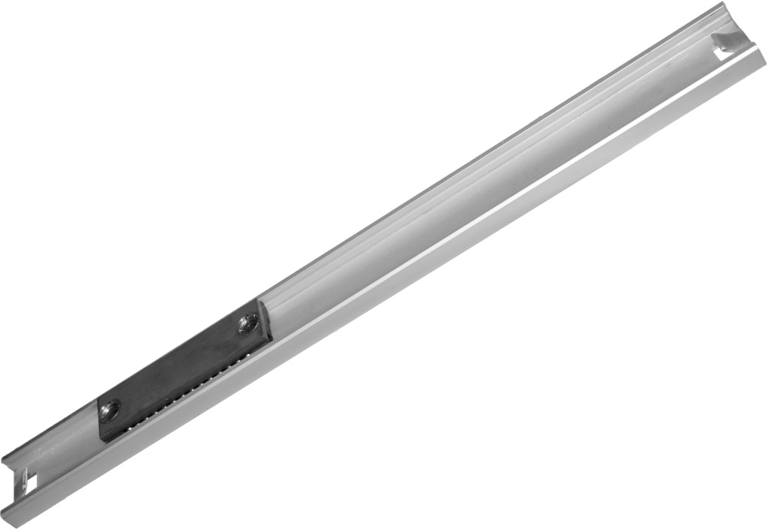
Boats : Access door
Markets & Examples
CHAMBRELAN
WWW.CHAMBRELAN.COM
Transportation | Plants & Machines | Electric & Electronic | Military | Specials

Slide 6
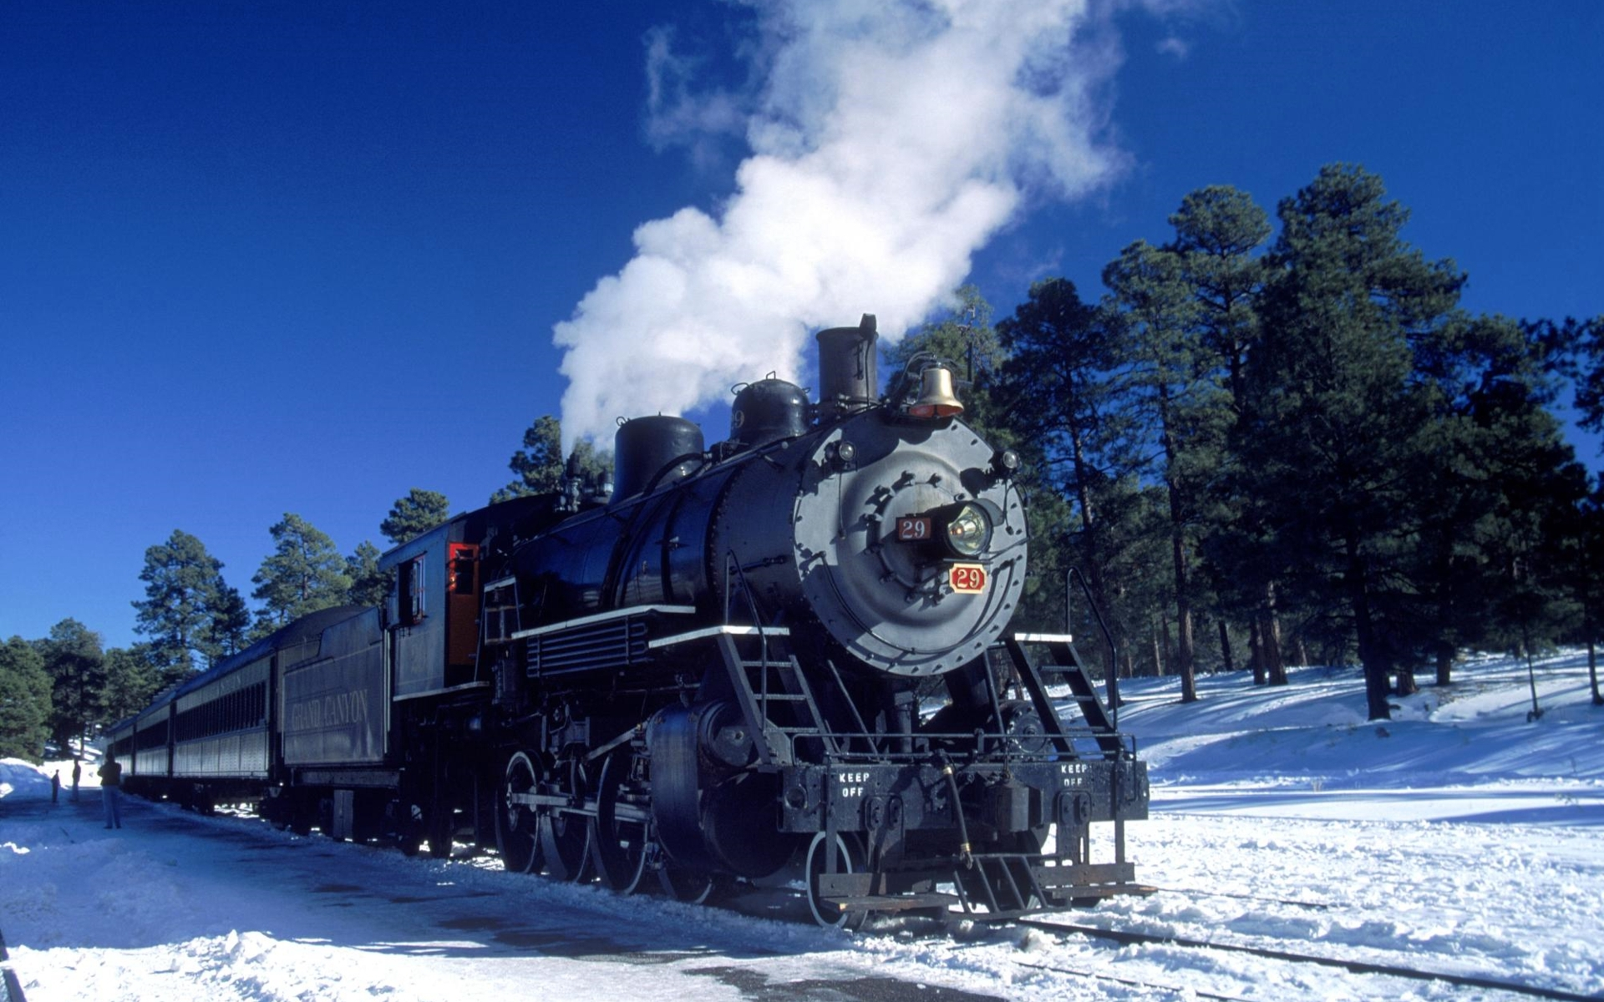
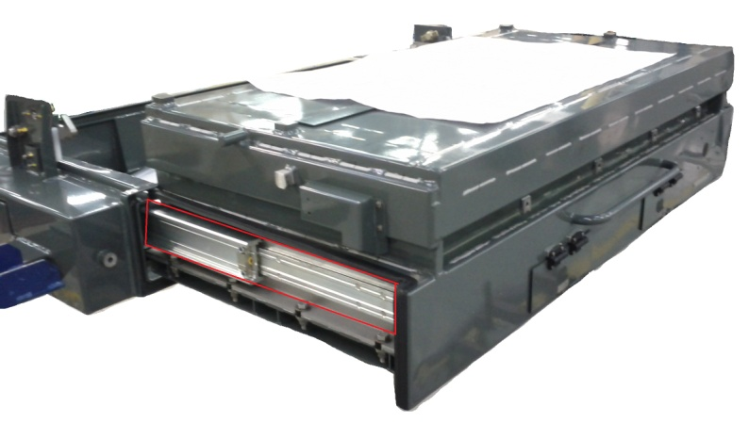
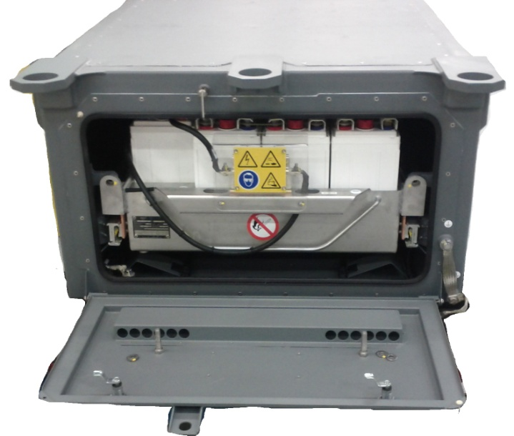
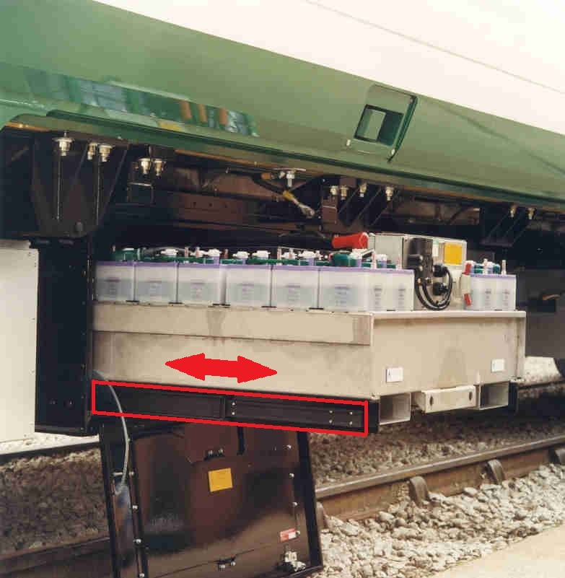
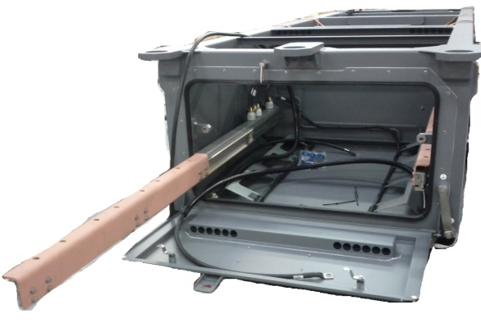
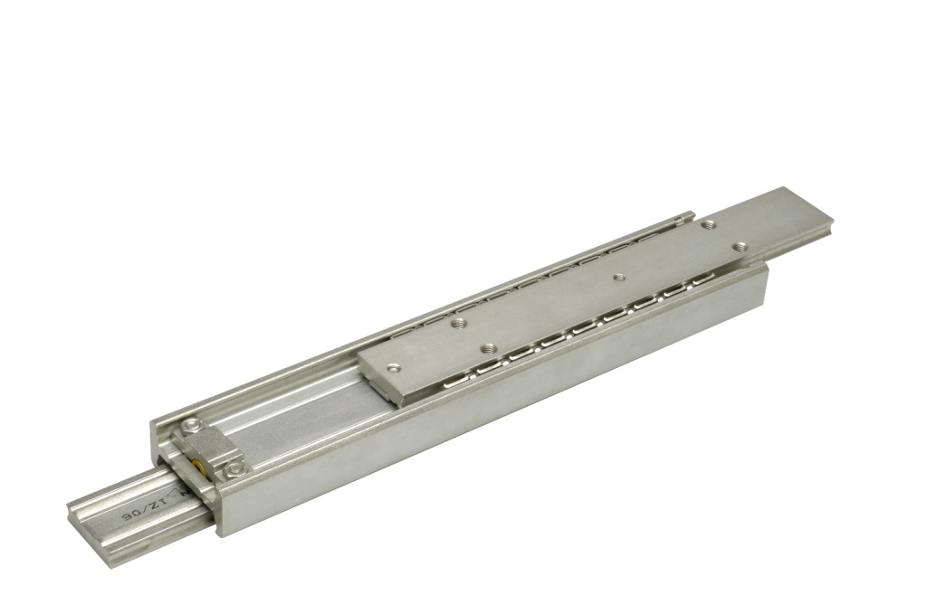
Trains > Batteries drawers
Markets & Examples
CHAMBRELAN
WWW.CHAMBRELAN.COM
Transportation | Plants & Machines | Electric & Electronic | Military | Specials

Slide 7
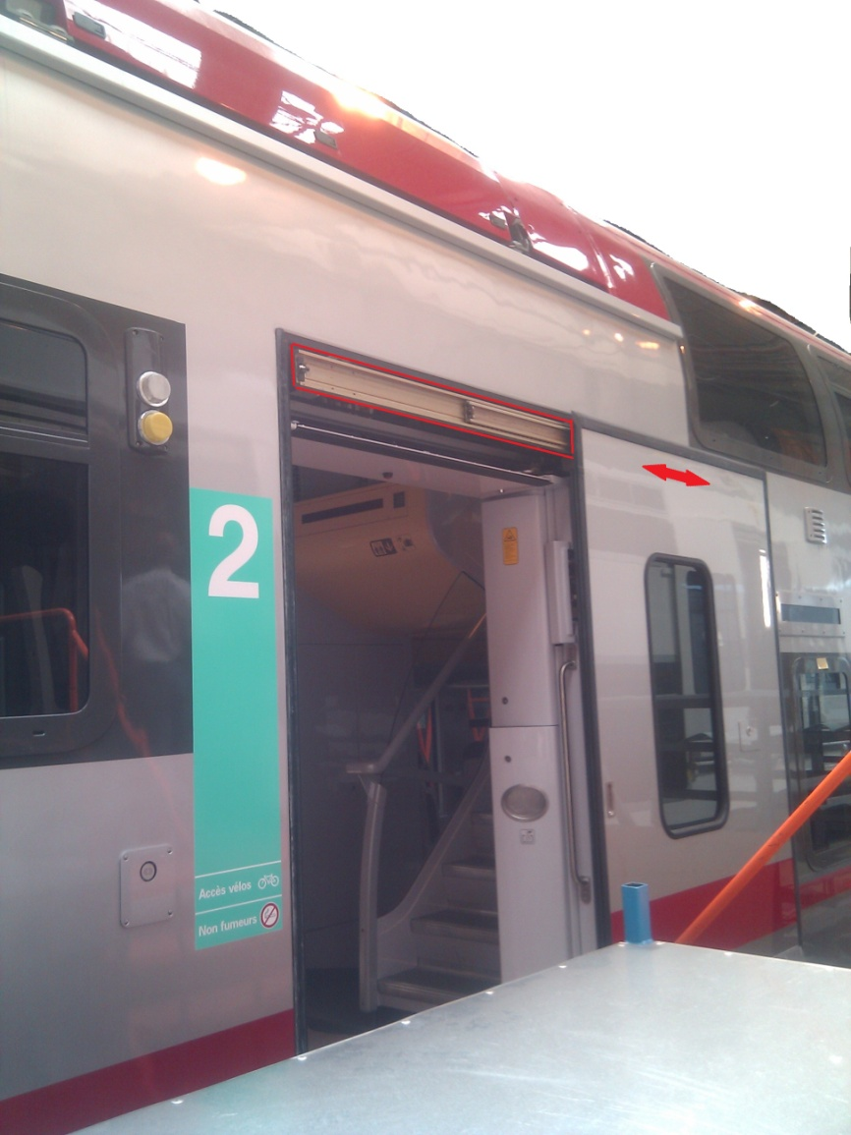
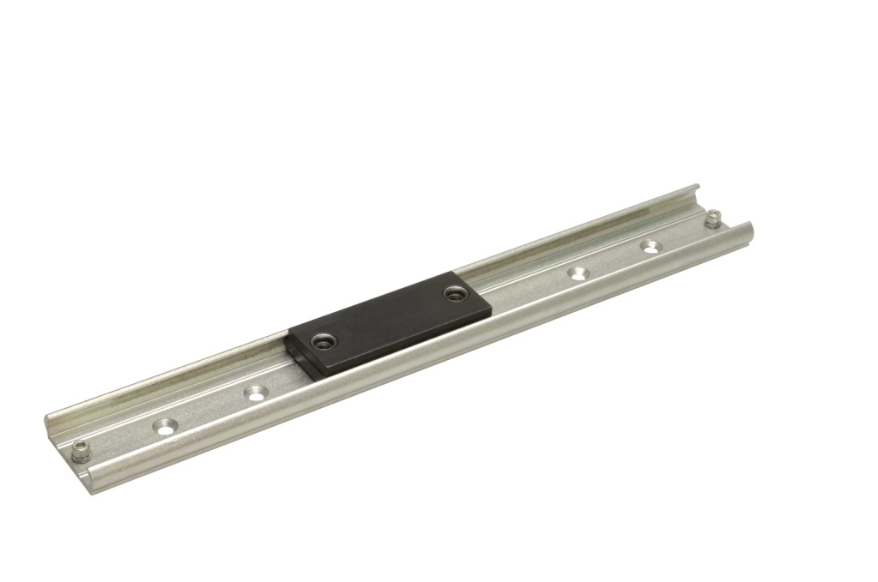
Trains > Doors
Markets & Examples
CHAMBRELAN
WWW.CHAMBRELAN.COM
Transportation | Plants & Machines | Electric & Electronic | Military | Specials

Slide 8
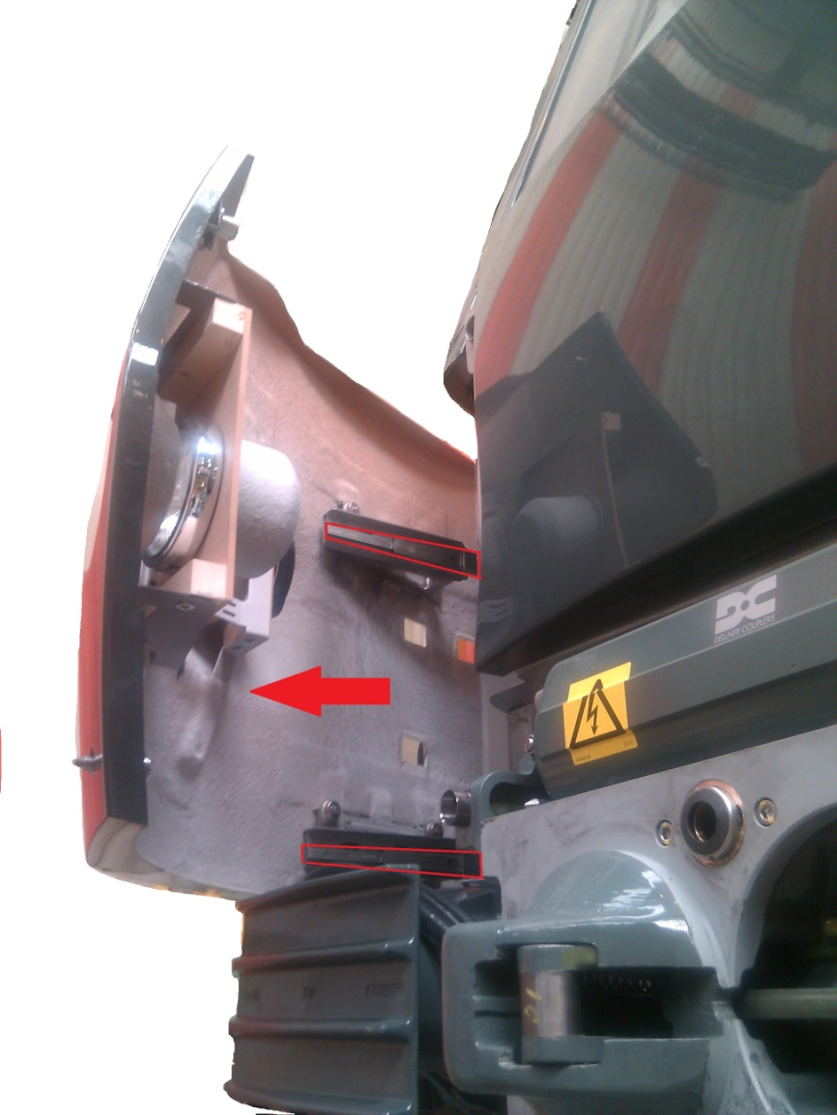
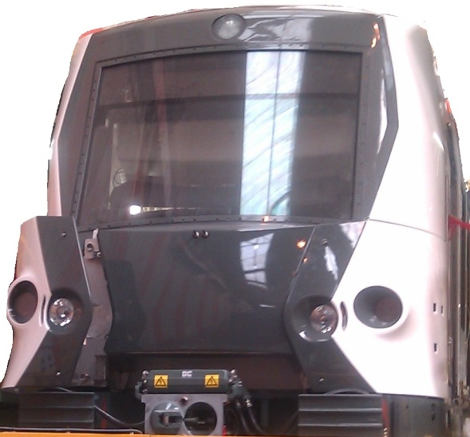
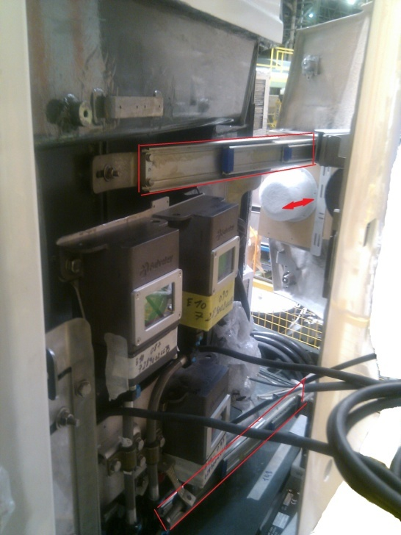
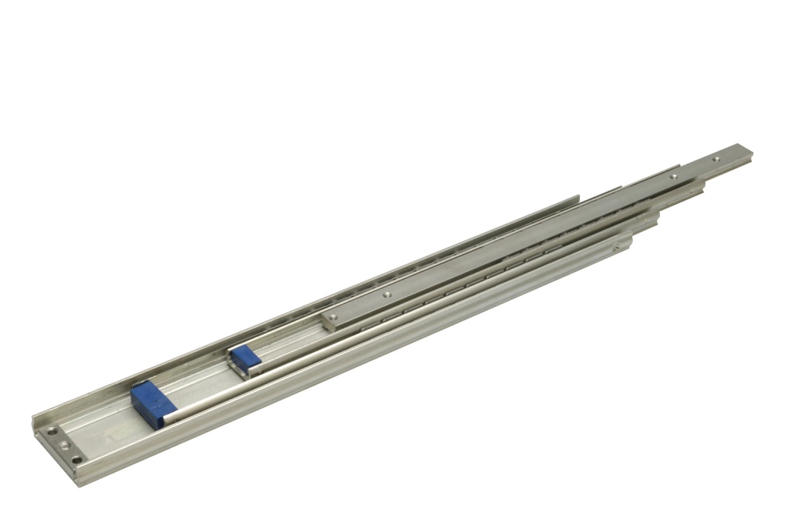
Trains > Maintenance access
Markets & Examples
CHAMBRELAN
WWW.CHAMBRELAN.COM
Transportation | Plants & Machines | Electric & Electronic | Military | Specials

Slide 9
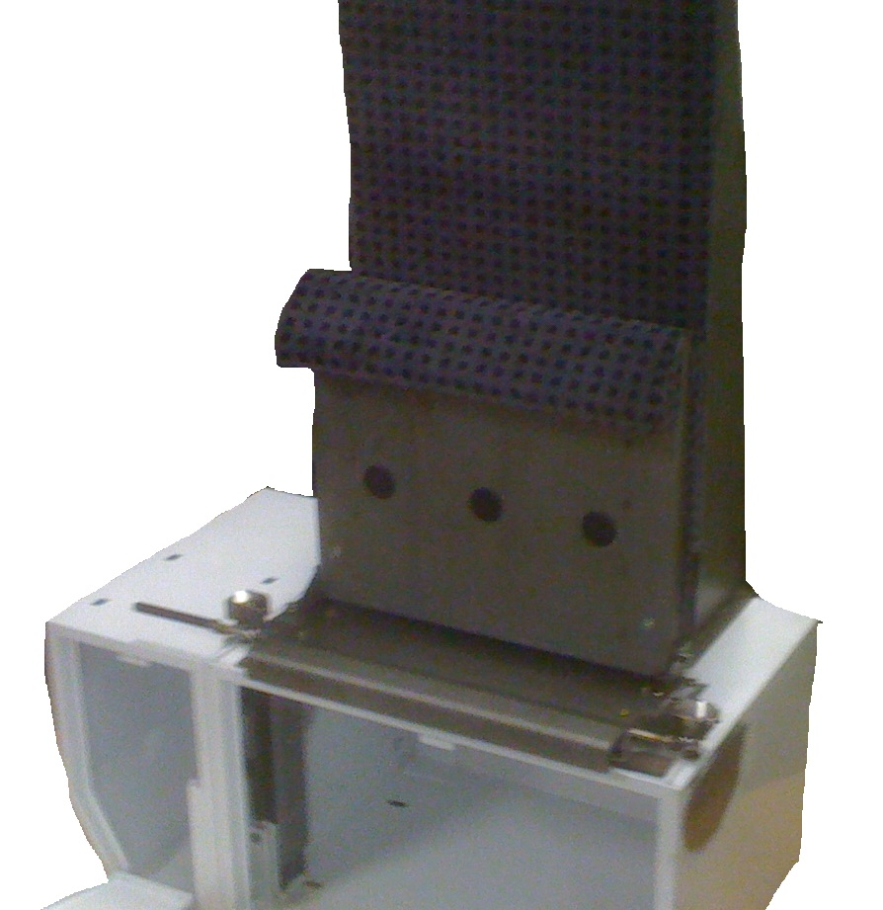
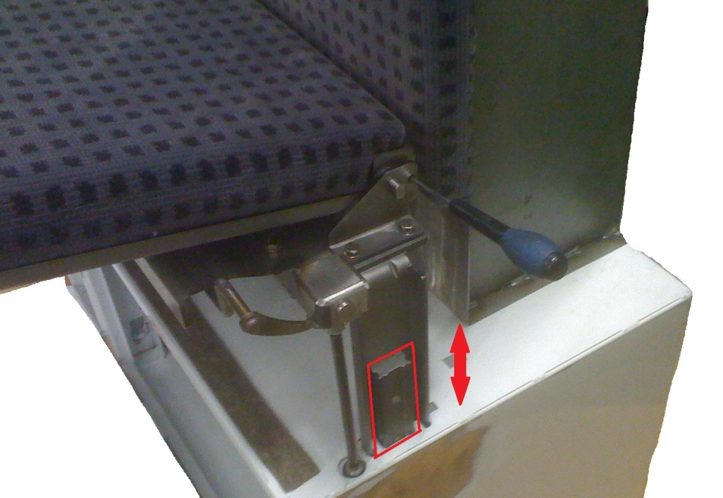
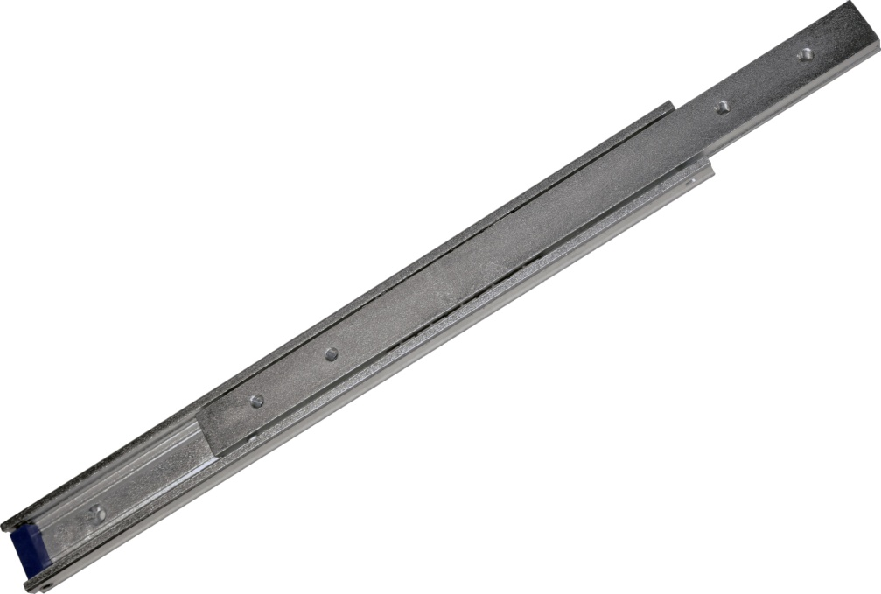
Trains > Driver seat
Markets & Examples
CHAMBRELAN
WWW.CHAMBRELAN.COM
Transportation | Plants & Machines | Electric & Electronic | Military | Specials

Slide 10
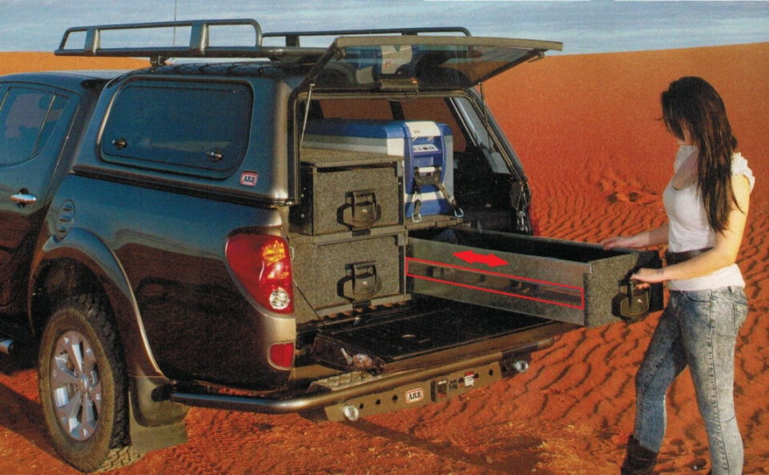
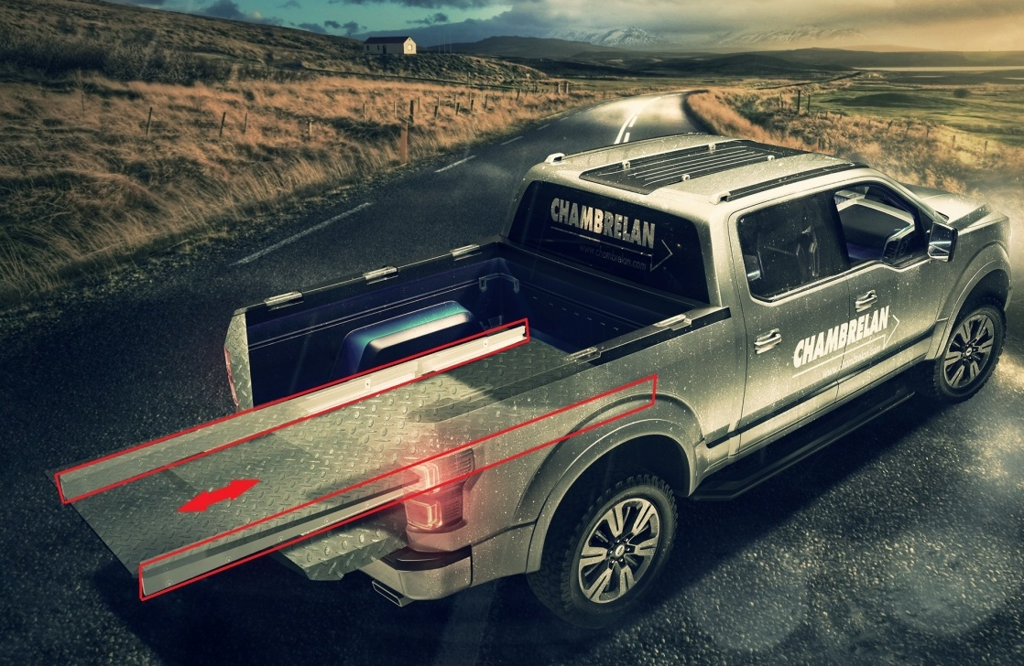
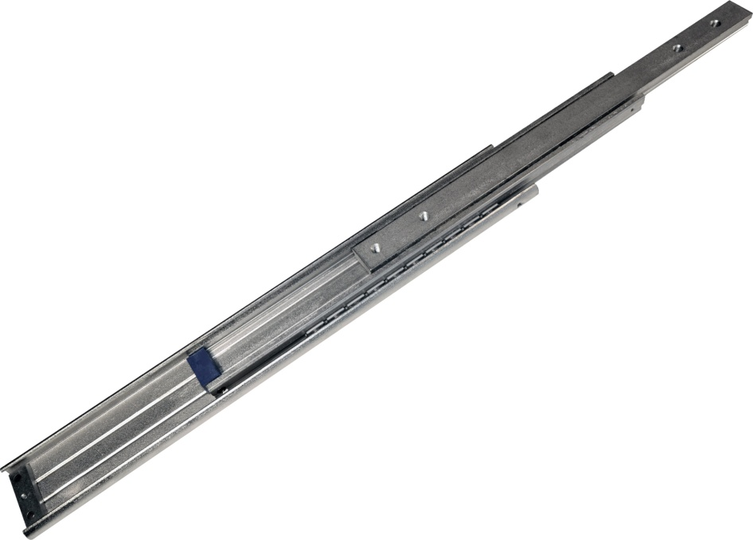
Vehicles > SUV furbishing
Markets & Examples
CHAMBRELAN
WWW.CHAMBRELAN.COM
Transportation | Plants & Machines | Electric & Electronic | Military | Specials

Slide 11
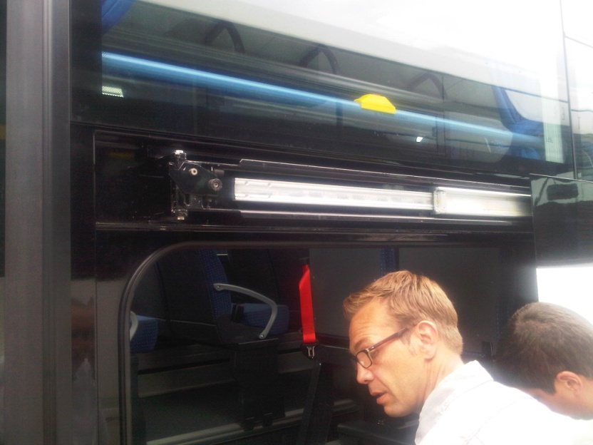
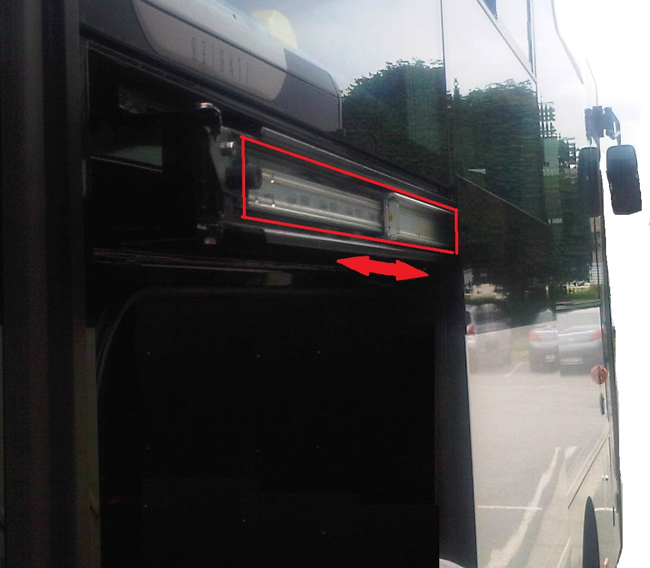
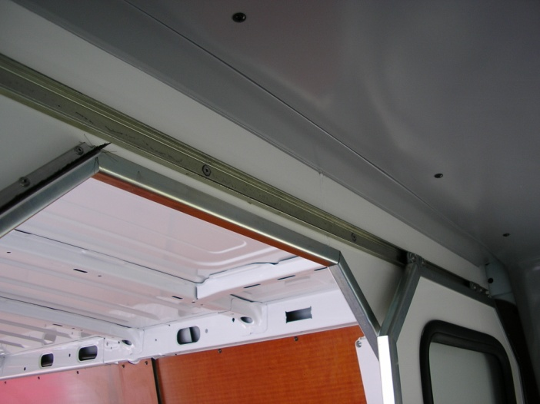
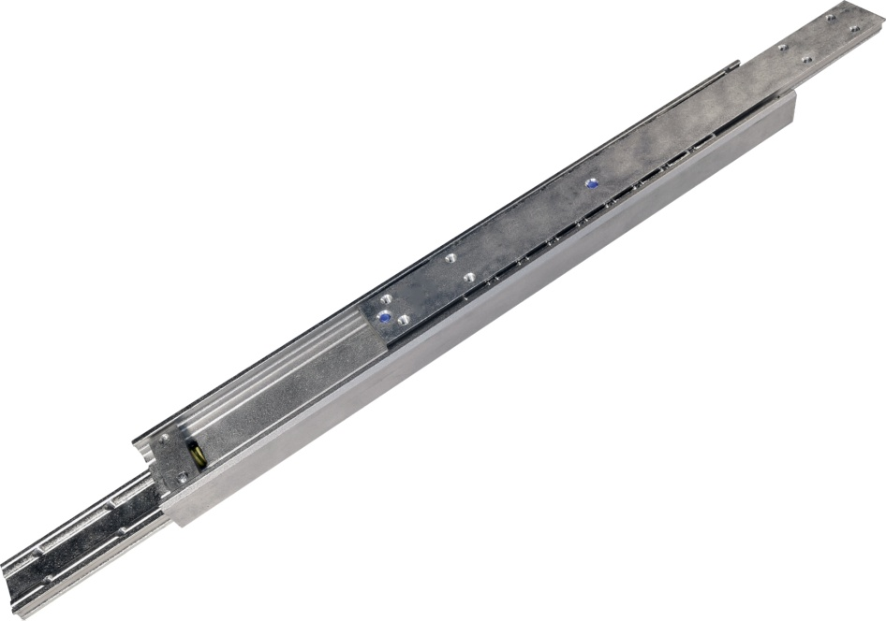
Vehicles > Coach door
Markets & Examples
CHAMBRELAN
WWW.CHAMBRELAN.COM
Transportation | Plants & Machines | Electric & Electronic | Military | Specials

Slide 12
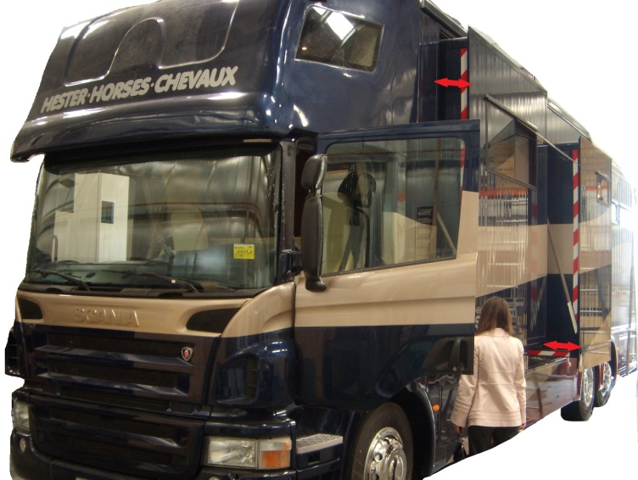
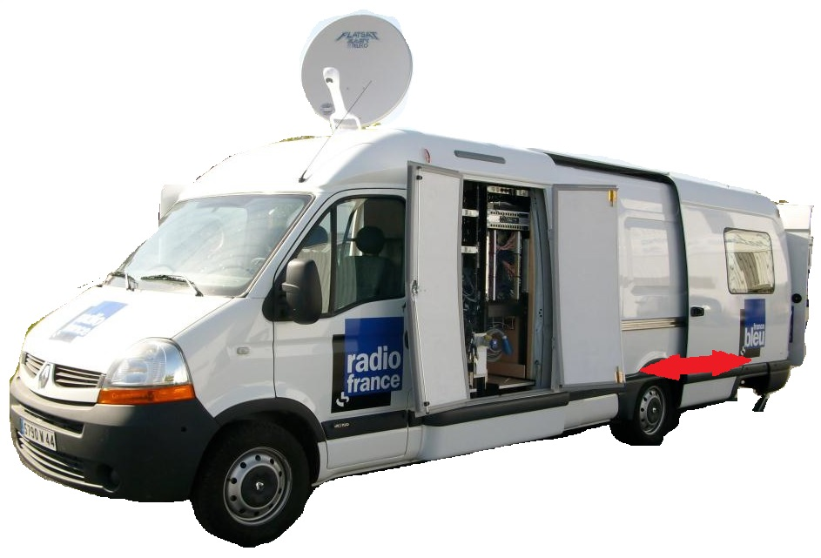
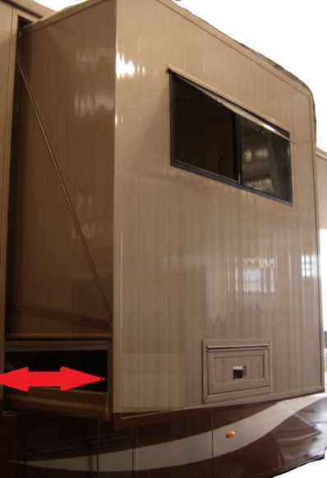
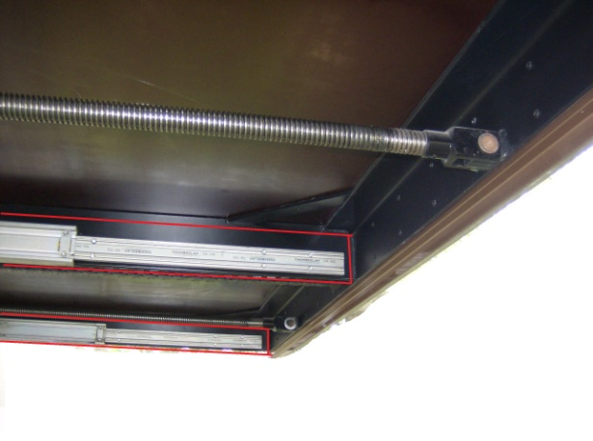
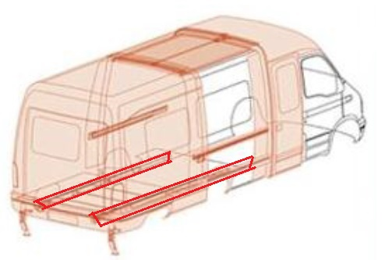
Vehicles > Extension
Markets & Examples
CHAMBRELAN
WWW.CHAMBRELAN.COM
Transportation | Plants & Machines | Electric & Electronic | Military | Specials

Slide 13
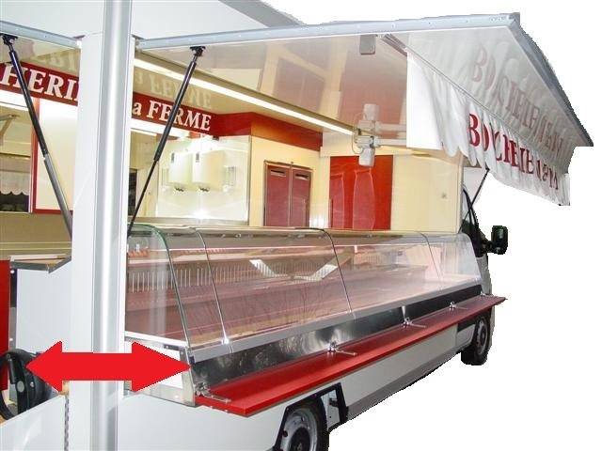
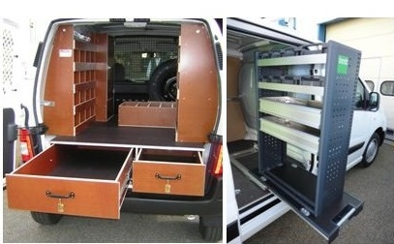
Vehicles > Street vendors – workshop vans
Markets & Examples
CHAMBRELAN
WWW.CHAMBRELAN.COM
Transportation | Plants & Machines | Electric & Electronic | Military | Specials

Slide 14
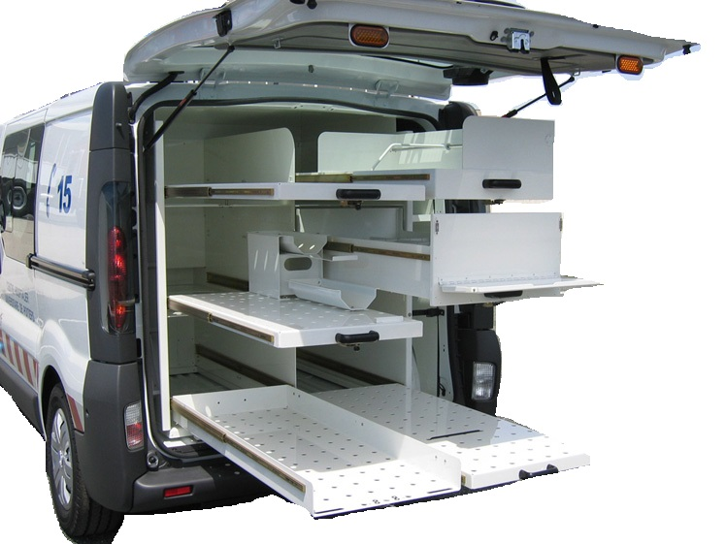
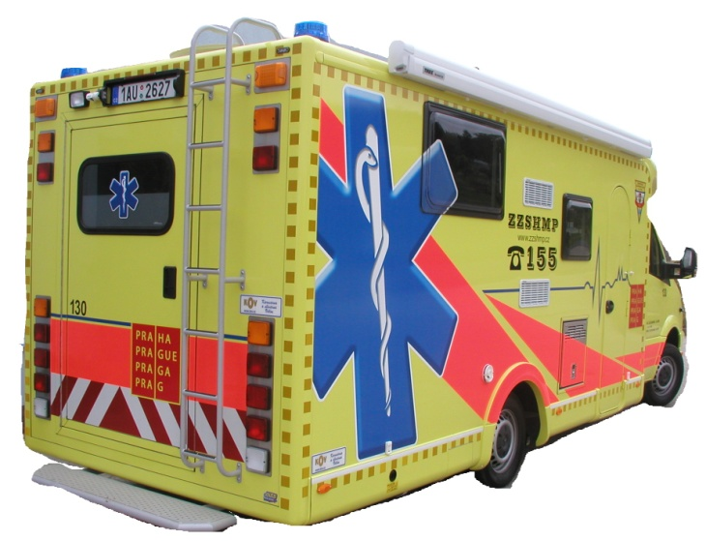
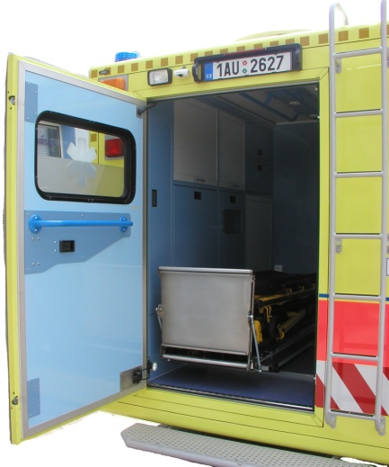
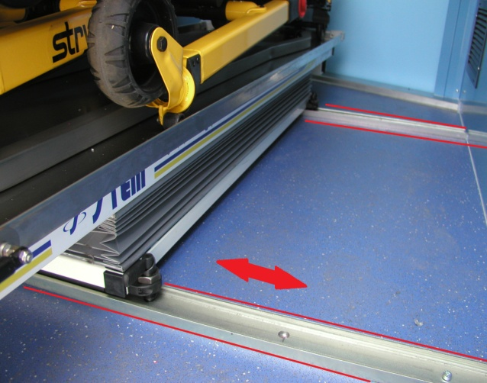
Vehicles > Ambulances
Markets & Examples
CHAMBRELAN
WWW.CHAMBRELAN.COM
Transportation | Plants & Machines | Electric & Electronic | Military | Specials

Slide 15
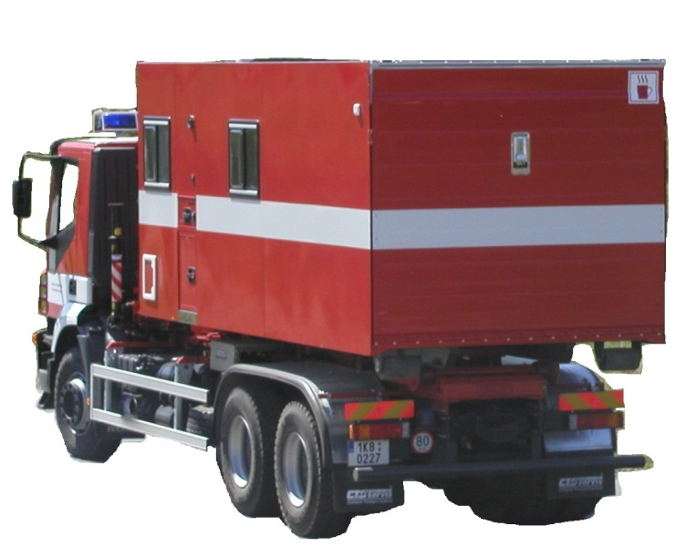
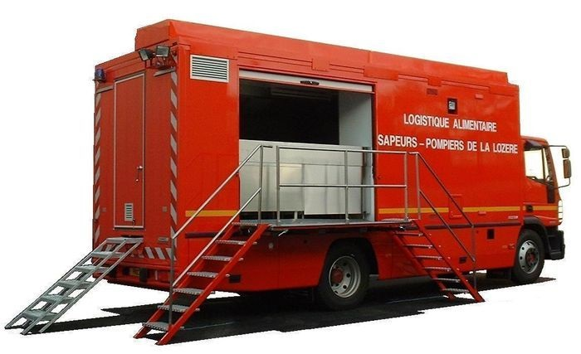
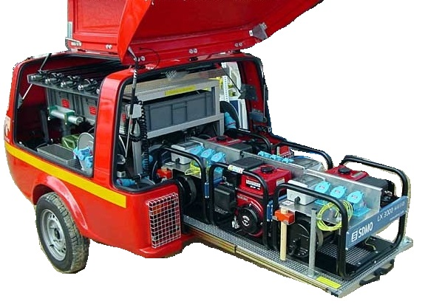
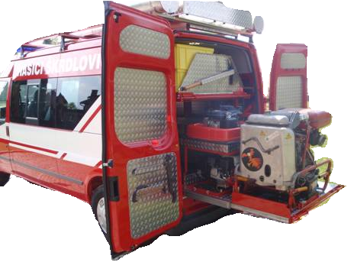
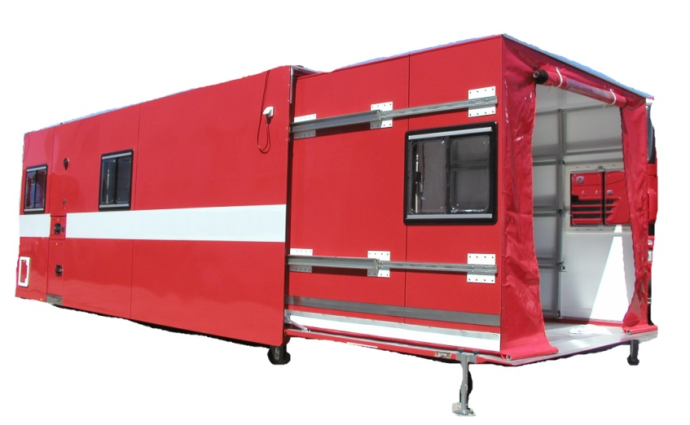
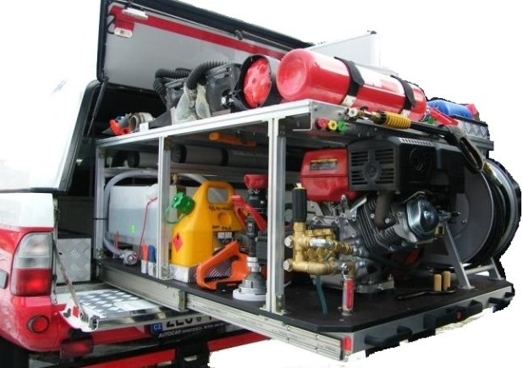
Vehicles > Emergency
Markets & Examples
CHAMBRELAN
WWW.CHAMBRELAN.COM
Transportation | Plants & Machines | Electric & Electronic | Military | Specials

Slide 16
Vehicles > special
Markets & Examples
CHAMBRELAN
WWW.CHAMBRELAN.COM
Transportation | Plants & Machines | Electric & Electronic | Military | Specials

Slide 17
Production line
Markets & Examples
CHAMBRELAN
WWW.CHAMBRELAN.COM
Transportation | Plants & Machines | Electric & Electronic | Military | Specials

Slide 18
Production line
Markets & Examples
CHAMBRELAN
WWW.CHAMBRELAN.COM
Transportation | Plants & Machines | Electric & Electronic | Military | Specials

Slide 19
Clean Rooms
Markets & Examples
CHAMBRELAN
WWW.CHAMBRELAN.COM
Transportation | Plants & Machines | Electric & Electronic | Military | Specials

Slide 20
Compressors
Markets & Examples
CHAMBRELAN
WWW.CHAMBRELAN.COM
Transportation | Plants & Machines | Electric & Electronic | Military | Specials

Slide 21
Food industry machines
Markets & Examples
CHAMBRELAN
WWW.CHAMBRELAN.COM
Transportation | Plants & Machines | Electric & Electronic | Military | Specials

Slide 22
Production lines feeding
Markets & Examples
CHAMBRELAN
WWW.CHAMBRELAN.COM
Transportation | Plants & Machines | Electric & Electronic | Military | Specials

Slide 23
Machines guards and covers
Markets & Examples
CHAMBRELAN
WWW.CHAMBRELAN.COM
Transportation | Plants & Machines | Electric & Electronic | Military | Specials

Slide 24
Furnaces
Markets & Examples
CHAMBRELAN
WWW.CHAMBRELAN.COM
Transportation | Plants & Machines | Electric & Electronic | Military | Specials

Slide 25
Safes
Markets & Examples
CHAMBRELAN
WWW.CHAMBRELAN.COM
Transportation | Plants & Machines | Electric & Electronic | Military | Specials

Slide 26
Transfer drawer (DD slides)
Markets & Examples
CHAMBRELAN
WWW.CHAMBRELAN.COM
Transportation | Plants & Machines | Electric & Electronic | Military | Specials

Slide 27
Postal sorting machine
Markets & Examples
CHAMBRELAN
WWW.CHAMBRELAN.COM
Transportation | Plants & Machines | Electric & Electronic | Military | Specials

Slide 28
Markets & Examples
CHAMBRELAN
WWW.CHAMBRELAN.COM
Transportation | Plants & Machines | Electric & Electronic | Military | Specials

Slide 29
19” racks
Markets & Examples
CHAMBRELAN
WWW.CHAMBRELAN.COM
Transportation | Plants & Machines | Electric & Electronic | Military | Specials

Slide 30
UPS Racks
Markets & Examples
CHAMBRELAN
WWW.CHAMBRELAN.COM
Transportation | Plants & Machines | Electric & Electronic | Military | Specials

Slide 31
Electronic Racks
Markets & Examples
CHAMBRELAN
WWW.CHAMBRELAN.COM
Transportation | Plants & Machines | Electric & Electronic | Military | Specials

Slide 32
Markets & Examples
CHAMBRELAN
WWW.CHAMBRELAN.COM
Transportation | Plants & Machines | Electric & Electronic | Military | Specials

Slide 33
Stretcher drawer
Markets & Examples
CHAMBRELAN
WWW.CHAMBRELAN.COM
Transportation | Plants & Machines | Electric & Electronic | Military | Specials

Slide 34
Mobile compressor unit
Markets & Examples
CHAMBRELAN
WWW.CHAMBRELAN.COM
Transportation | Plants & Machines | Electric & Electronic | Military | Specials

Slide 35
Screen & radar display
Markets & Examples
CHAMBRELAN
WWW.CHAMBRELAN.COM
Transportation | Plants & Machines | Electric & Electronic | Military | Specials

Slide 36
Tanks : drawers
Markets & Examples
CHAMBRELAN
WWW.CHAMBRELAN.COM
Transportation | Plants & Machines | Electric & Electronic | Military | Specials

Slide 37
Tanks : seats
Markets & Examples
CHAMBRELAN
WWW.CHAMBRELAN.COM
Transportation | Plants & Machines | Electric & Electronic | Military | Specials

Slide 38
Simulator
Markets & Examples
CHAMBRELAN
WWW.CHAMBRELAN.COM
Transportation | Plants & Machines | Electric & Electronic | Military | Specials

Slide 39
Markets & Examples
CHAMBRELAN
WWW.CHAMBRELAN.COM
Transportation | Plants & Machines | Electric & Electronic | Military | Specials

Slide 40
Observatory
Markets & Examples
CHAMBRELAN
WWW.CHAMBRELAN.COM
Transportation | Plants & Machines | Electric & Electronic | Military | Specials

Slide 41
Fire Place cover
Markets & Examples
CHAMBRELAN
WWW.CHAMBRELAN.COM
Transportation | Plants & Machines | Electric & Electronic | Military | Specials

Slide 42
Kitchen cooker hoods
Markets & Examples
CHAMBRELAN
WWW.CHAMBRELAN.COM
Transportation | Plants & Machines | Electric & Electronic | Military | Specials

